Slide 1
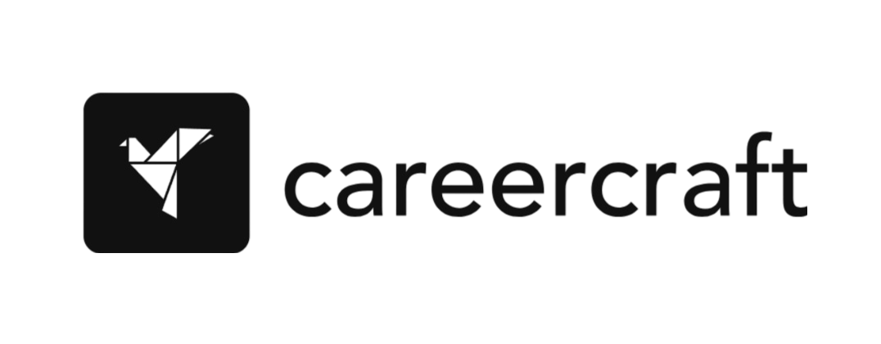

CareerCraft: Empowering Individuals in the Evolving Job Market
Presented By :
Mohsin Ali (2200291530067)
Prachi Goel (2200291520125)
Vidhika Mohan (2200291530132)
Tanushka Nehra(2200291530120)

Slide 2

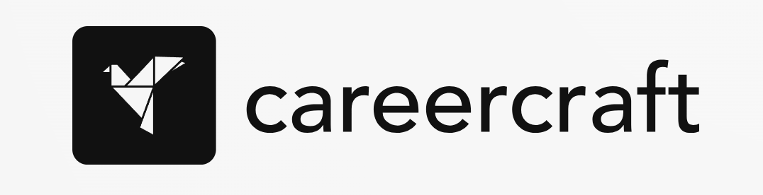
Our Problem Statement
1
Fragmentation in Learning
2
Lack of Personalization
3
Limited Guidance
Traditional educational platforms often offer fragmented resources without cohesive career development plans. This leaves learners feeling lost and overwhelmed.
Individuals struggle to find courses tailored to their unique skills, interests, and career aspirations. Generic learning paths don't cater to specific needs.
Many individuals lack access to mentorship and guidance from experienced professionals who can provide insights and support their career journeys.

Slide 3

Challenges Faced by Learners
Finding Relevant Courses
Building a Structured Path
Searching through vast online libraries of courses can be time-consuming and overwhelming, making it difficult to discover resources aligned with specific goals.
Without clear learning pathways, individuals struggle to connect different courses into a cohesive plan that leads to desired outcomes.
Lack of Accountability
Learning independently can be challenging, as learners often lack motivation, structure, and external support to stay on track.

Slide 4





Our Solution: CareerCraft
Personalized Plans
Curated Recommendations
CareerCraft provides tailored career development plans based on individual skills, interests, and goals, ensuring a focused and effective learning journey.
Our platform offers curated course recommendations aligned with individual career goals, ensuring access to high-quality and relevant learning resources.
Mentorship & Guidance
Lifelong Learning
CareerCraft connects learners with experienced mentors who provide personalized support, guidance, and valuable industry insights.
We foster a culture of continuous learning, enabling individuals to adapt to changing job market trends and stay ahead of the curve.

Slide 5

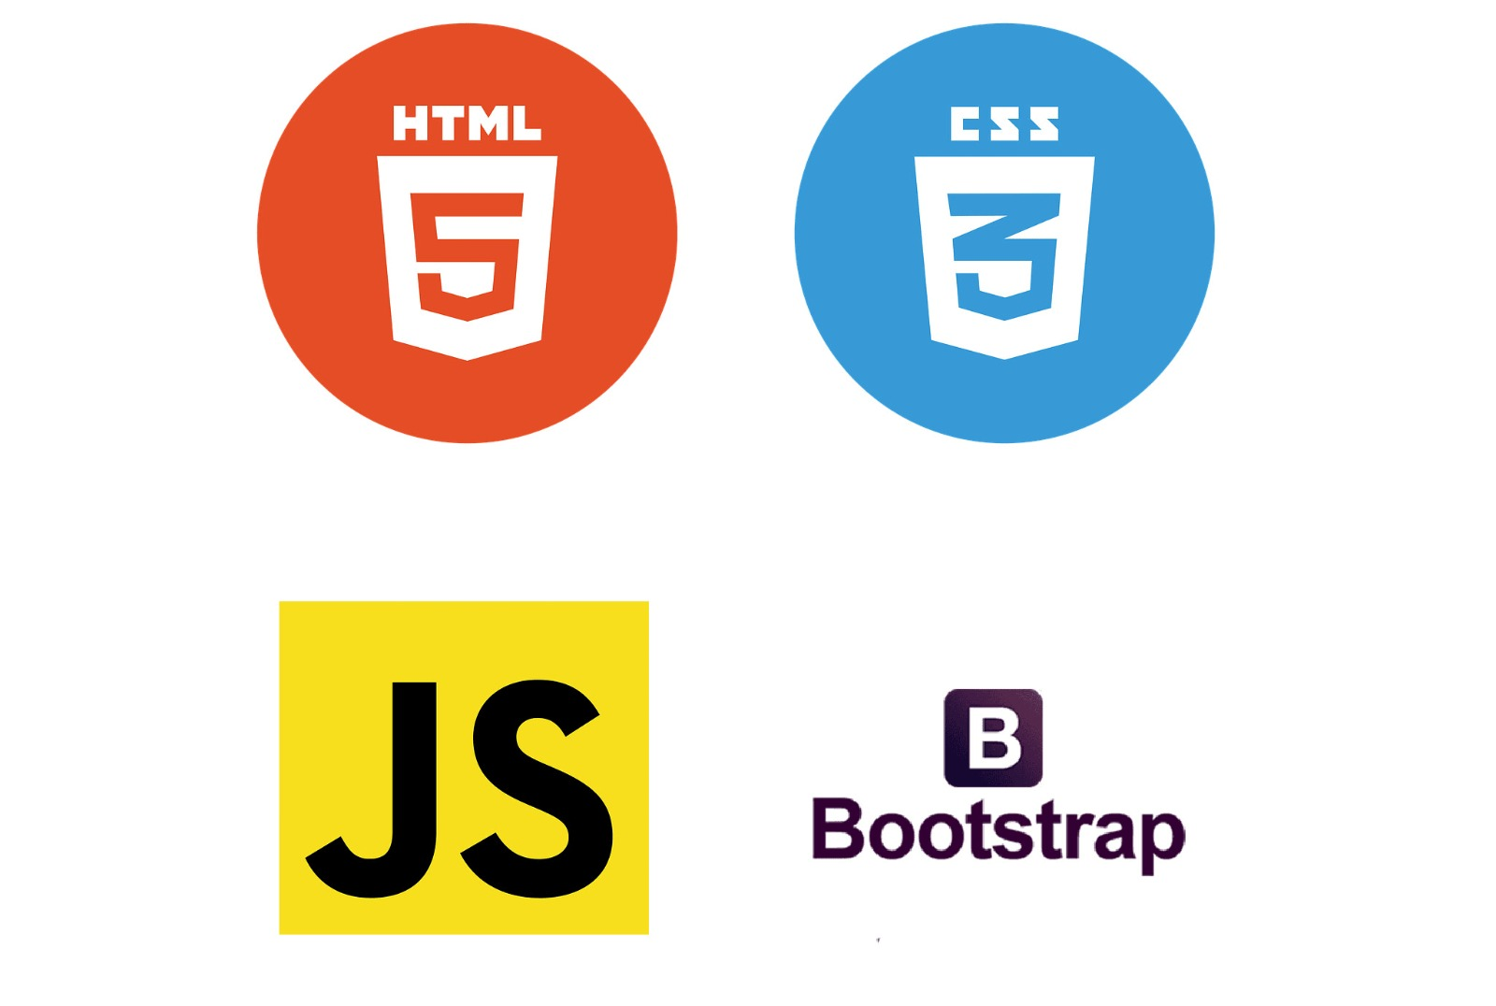
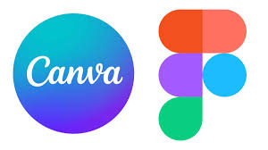
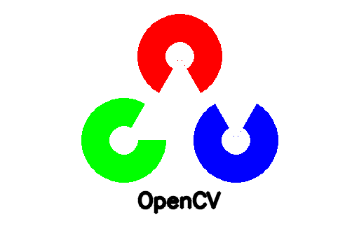
Technology Stack
Django: As the backend framework, Django will handle user management, authentication, course content management, and provide a robust, scalable platform. Django's ORM will allow seamless integration with databases to store user progress, test results, and course materials.
Web Development (HTML, CSS, JavaScript, Bootstrap): This will ensure a clean, responsive, and interactive front-end experience. With Bootstrap for styling, the platform will offer a professional and user-friendly interface, making navigation easy for both learners and instructors
Figma will be used for UI/UX design, enabling the creation of interactive prototypes and wireframes, ensuring an intuitive, responsive user experience. Figma’s collaboration features will allow seamless feedback and iteration on the design. Canva, on the other hand, will handle quick graphic design tasks, including creating visually appealing banners, social media graphics, and marketing materials.
For proctored assessments and tests, OpenCV will be used for real-time monitoring of learners. This tool will allow facial recognition, ensuring that learners are paying attention and not engaging in any form of malpractice during assessments.

Slide 6
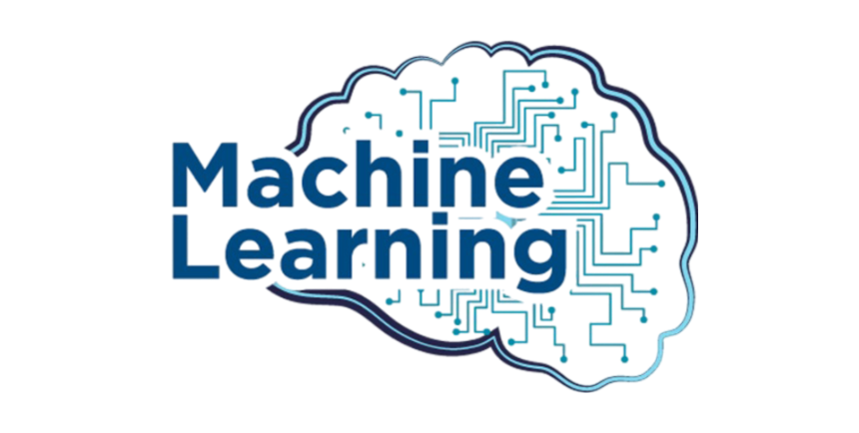
ML Algorithms used :
Machine learning algorithms will be employed to personalize the learning experience for each user. This will include:
Recommendation Systems: Based on a user's learning progress, strengths, and weaknesses, the platform will recommend appropriate courses, additional resources, and study materials.
Performance Analysis: Machine learning models will analyze test results and study patterns to identify areas for improvement. This will enable adaptive learning paths tailored to individual users.
Career Path Guidance: Using data from industry trends, user performance, and skills demand, machine learning models will provide career suggestions, helping learners align their learning with market needs.

Slide 7
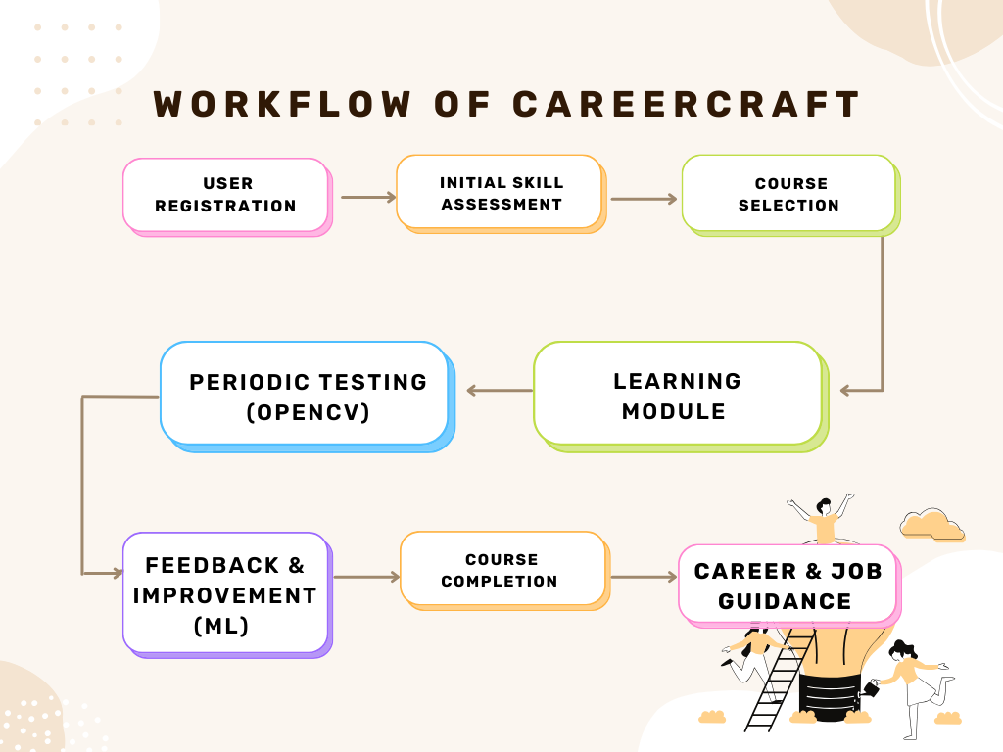


Slide 8

Market and Growth Strategy :
1
Content Partnerships:
2
Digital Marketing:
Collaborate with top content creators, universities, and subject matter experts to develop high-quality learning materials and certifications..
Invest in SEO, social media campaigns, and influencer marketing to reach our target audience.
4
3
Corporate Sales:
4
Community Engagement:
Develop relationships with companies that need to upskill their workforce, providing B2B services for employee training.
Build a strong community where learners can share their progress, success stories, and challenges, driving word-of-mouth growth.

Slide 9

Competitive Analysis :
While there are several educational platforms available (Coursera, Udemy, edX, etc.), most of them focus on individual courses without providing an end-to-end career development solution.
CareerCraft will differentiate itself by:
1
Offering structured career pathways instead of just fragmented courses.
2
Providing personalized feedback and AI-driven assessments
to ensure skill mastery.
3
Building a mentorship network to guide learners throughout their
journey.
4
Ensuring a direct link to job opportunities, closing the gap
between education and employment.

Slide 10
SUMMARY
CareerCraft is a guided career development platform designed to help users
navigate their career paths from learning to employment.
It offers personalized, structured learning paths based on initial skill assessments.
Users progress through curated courses, periodically taking tests
monitored by OpenCV to ensure fairness.
Machine learning analyzes test results and adapts study plans to focus on areas of improvement.
Upon course completion, users receive tailored career guidance,
including job recommendations based
on their performance and market trends. The platform integrates mentorship,
AI-driven feedback, and industry partnerships to bridge the gap between education and
real-world employment.

